Slide 1







MPR Assigment 3
Expense tracker App
Pham Quang Hai _2101040079

Slide 2


Table of contents
How to run the file
Step to create an app
Screen for app

Slide 3






How to run the file
Dowload file and unzip
Run “Npm install”
Execute command “Npm run android”

Slide 4




Steps to create app
All expense
Modify code to activate the featur
Click on add icon/ Add expenses button -> show form to enter expense info
Click on expense items -> show all the data allow users to update it

Slide 5
Steps to create app
Recent expense
Modify code to activate the featur
Click on add icon/ Add expenses button -> show form to enter expense info
Click on expense items -> show all the data allow users to update it
Show all expenses in just 7 days

Slide 6
Steps to create app
Manage expense
Modify code to activate the feature
Handle the action after click on save or submit

Slide 7
























All The screens

Slide 8
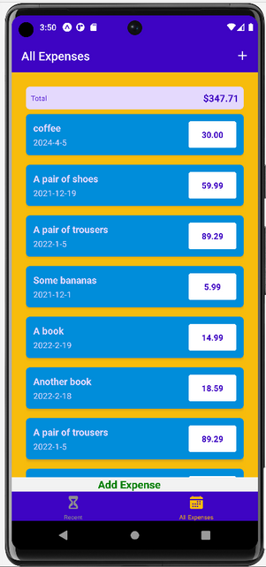
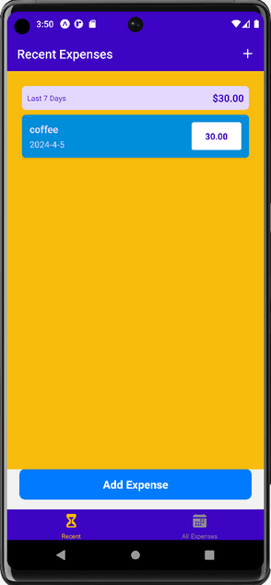
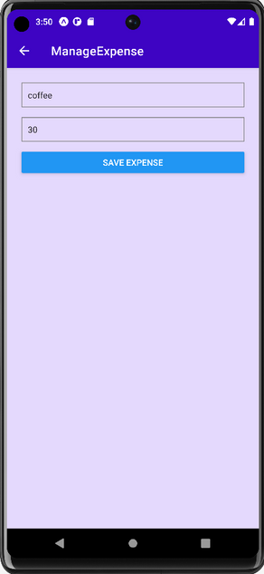
All expenses
Recent expenses
Manage expenses

Slide 9
Thank you for viewing my explanation
Pham Quang Hai _2101040079

